Slide 1
Restaurants & Coffee Shops on Campus

Slide 2
Are you satisfied with the restaurants on/near campus?
Yes, yes, yes, yes, NO
4 out of 5 respondents were satisfied with the restaurants on/near campus

Slide 3
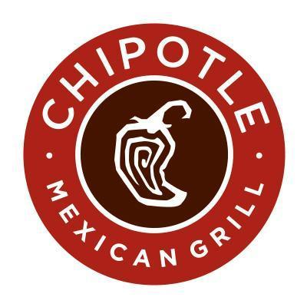
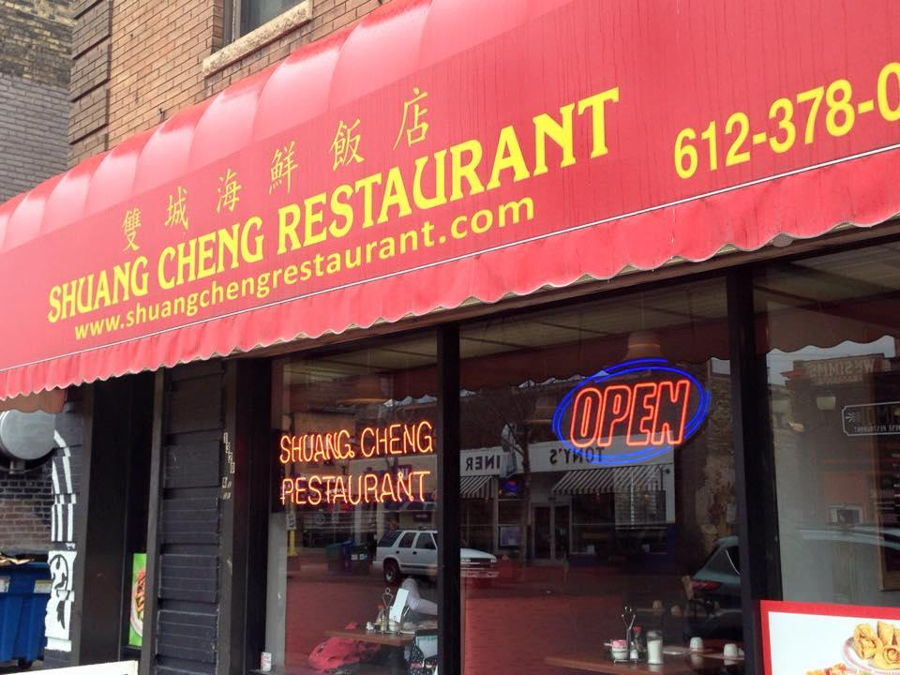
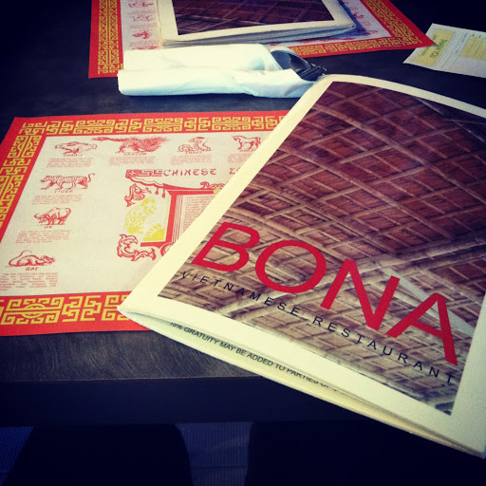
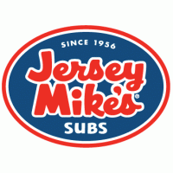

Which restaurant(s) on/near campus do you frequent the most and why?
Chipotle → I like their food
Shuang Cheng → because I love Chinese food.
Bona → It is a Vietnamese restaurant and I really like Asian food in general.
Jersey Mikes. → It's the most delicious.
Mesa. → Yummy.

Slide 4

Are you satisfied with the price range of the restaurants on/near campus?
Yes, yes, yes, yes, yes
100% of the respondents were satisfied

Slide 5
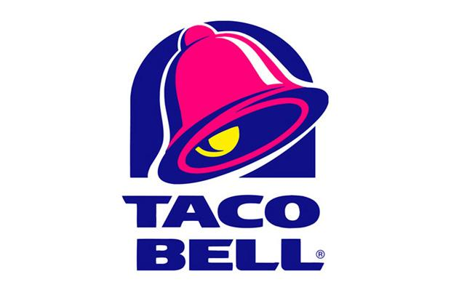
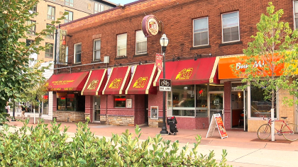

Is there a restaurant you would like to see added on/near campus?
Village Wok
Taco Bell
A Thai place
Bun Mi. RIP

Slide 6
Are you satisfied with the coffee shops on/near campus?
Yes, yes, yes, yes, yes
100% of the respondents were satisfied

Slide 7
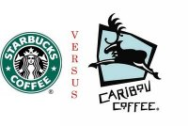
Which coffee shop(s) on/near campus do you frequent the most and why?
Starbucks → convenient locations
Caribou
Starbucks → like their coffee.
Caribou. → Yummy.
Caribou. → It's the best.

Slide 8

Are you satisfied with the price range of the coffee shops on/near campus?
Yes, yes, yes, yes, NO
4 out of 5 respondents were satisfied

Slide 9


Is there a coffee shop you would like to see added on/near campus?
Spyhouse

